Slide 1
Pretraživanje stringova pomoću BWT i FM indeksa
Marija Kostić 2019/3023
Genomska Informatika

Slide 2
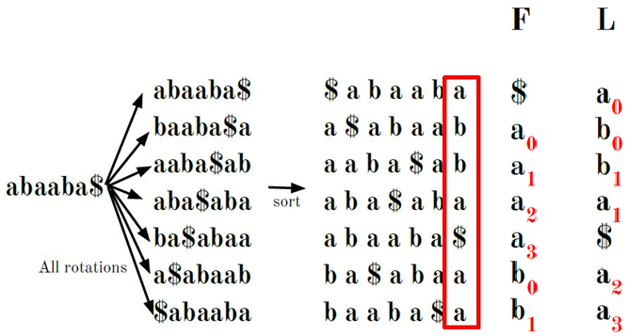
Burrows -Wheeler Transformacija
Reverzibilna permutacija string
Koristi se kompresiju podataka
Omogućava brzu pretragu podstringova u okviru string
B-rank je nekog znaka je broj pojavljivanja tog znaka u stringu do mesta gde se on nalazi. Koristi se za pronalazak originalnog string od njegove BWT

Slide 3
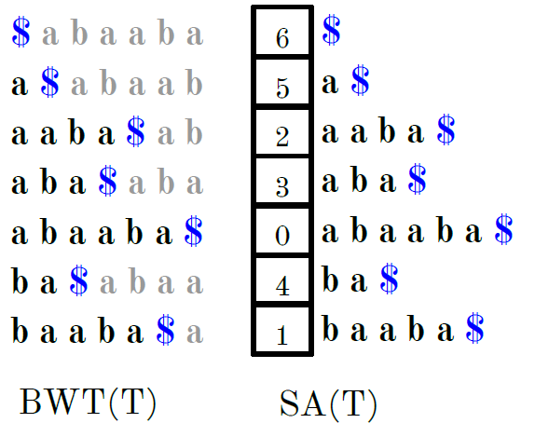
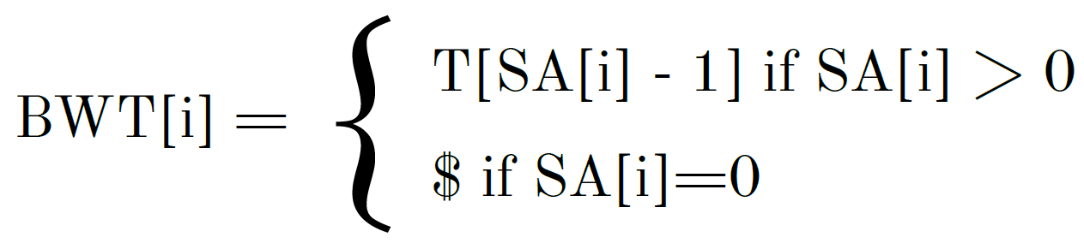
Konstrukcija BW transformacija
Sortirani redosled je isti bez obzira na to da li se sortiraju rotacije ili sufiksi string
Brzina formiranja Burrows-Wheeler transformacije zavisi od brzine formiranja sufiksnog niza

Slide 4
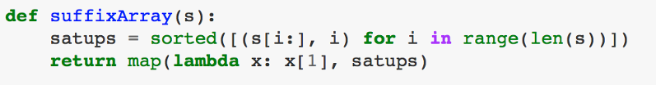
Konstrukcija sufiksnog niza
Osnovna verzija za kreiranje sufiksnog niza nije održiva za velike stringove. Na primeru stringa od milion karaktera bilo je potrebno više od 5 minuta.
Algoritam | Opis
DC | Difference-Cover algorithm (v = 32)
DS | Deep-Shallow sorting algorithm
KA | Ko-Alur algorithm
KS | Kärkkäinen-Sanders algorithm
LS | Larsson-Sadakane algorithm
sais | Induced Sorting algorithm
Notes:
Složenost je O(n^2*ln(n))
sais is a very simple and small library that provides an implementation of the induced sorting [1] based suffix array construction algorithm. The algorithm runs in O(n) worst-case time, and MAX(2n, 4k) worst-case extra working space, where n and k are the length of the input string and the number of alphabets.

Slide 5
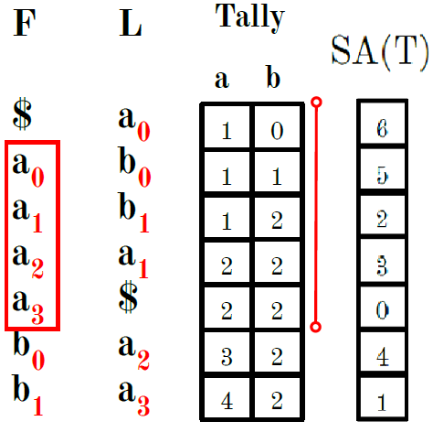
FM-Index
Kompresovani indeks podstringova nekog teksta koji je baziran na BWT.
OSNOVNA verzija algoritma
Ceo sufiksni niz
Ceo B-rang niz
OPTIMIZOVANA verzija algoritma
Proređeni sufiksni niz (faktor = 128)
Proređena Tally matrica (faktor = 128)

Slide 6
4170 MB | coffea arabica [50MB] |  |  |  |  | 4170 MB | coffea arabica [50MB]
tally/suffix | 4 | 16 | 64 | 256 |  | tally/suffix | 4 | 16 | 64 | 256
8 | 1550 | 1180 | 1090 | 1066 |  | 8 | 2.69 | 3.53 | 3.83 | 3.91
32 | 995 | 627 | 535 | 512 |  | 32 | 4.19 | 6.65 | 7.79 | 8.14
128 | 812 | 444 | 352 | 330 |  | 128 | 5.14 | 9.39 | 11.85 | 12.64
512 | 765 | 396 | 304 | 280 |  | 512 | 5.45 | 10.53 | 13.72 | 14.89
7555 MB | canis lupus familiaris [90MB] |  |  |  |  | 7555 MB | canis lupus familiaris [90MB]
tally/suffix | 4 | 16 | 64 | 256 |  | tally/suffix | 4 | 16 | 64 | 256
8 | 2925 | 2260 | 2095 | 2053 |  | 8 | 2.58 | 3.34 | 3.61 | 3.68
32 | 1790 | 1126 | 958 | 919 |  | 32 | 4.22 | 6.71 | 7.89 | 8.22
128 | 1455 | 788 | 622 | 580 |  | 128 | 5.19 | 9.59 | 12.15 | 13.03
512 | 1370 | 705 | 535 | 495 |  | 512 | 5.51 | 10.72 | 14.12 | 15.26
12180 MB | mus Pahari [143MB] |  |  |  |  | 12180 MB | mus Pahari [143MB]
tally/suffix | 4 | 16 | 64 | 256 |  | tally/suffix | 4 | 16 | 64 | 256
8 | 4388 | 3315 | 3047 | 2977 |  | 8 | 2.78 | 3.67 | 4.00 | 4.09
32 | 2785 | 1710 | 1437 | 1373 |  | 32 | 4.37 | 7.12 | 8.48 | 8.87
128 | 2310 | 1240 | 968 | 901 |  | 128 | 5.27 | 9.82 | 12.58 | 13.52
512 | 2190 | 1116 | 845 | 780 |  | 512 | 5.56 | 10.91 | 14.41 | 15.62
Apsolutno zauzeće memorije u MB optimizovane verzije algoritma
Zauzeće memorije optimizovanog algoritma u odnosu na osnovni algoritam
ZAUZEĆE MEMORIJE
Notes:
Za sve fajlove je umanjenje proporcionlno skoro isto

Slide 7
0.00216 sec | coffea arabica - ATGCATG[6529] |  |  |  |  | 0.00216 sec | coffea arabica - ATGCATG[6529]
tally/suffix | 4 | 16 | 64 | 256 |  | tally/suffix | 4 | 16 | 64 | 256
8 | 0.06830 | 0.30200 | 1.19000 | 4.62500 |  | 8 | 31.62 | 139.81 | 550.93 | 2141.20
32 | 0.11290 | 0.51300 | 2.25600 | 8.32800 |  | 32 | 52.27 | 237.50 | 1044.44 | 3855.56
128 | 0.28400 | 1.36800 | 5.71200 | 22.80120 |  | 128 | 131.48 | 633.33 | 2644.44 | 10556.11
512 | 0.99200 | 4.73620 | 19.70900 | 81.45400 |  | 512 | 459.26 | 2192.69 | 9124.54 | 37710.19
0.000451 sec | coffea arabica - TCTCTCTA[1262] |  |  |  |  | 0.000451 sec | coffea arabica - TCTCTCTA[1262]
tally/suffix | 4 | 16 | 64 | 256 |  | tally/suffix | 4 | 16 | 64 | 256
8 | 0.01340 | 0.05600 | 0.23300 | 0.92100 |  | 8 | 29.71 | 124.17 | 516.63 | 2042.13
32 | 0.02100 | 0.09800 | 0.44500 | 1.66800 |  | 32 | 46.56 | 217.29 | 986.70 | 3698.45
128 | 0.05280 | 0.26200 | 1.13600 | 4.55000 |  | 128 | 117.07 | 580.93 | 2518.85 | 10088.69
512 | 0.19000 | 0.92300 | 3.98400 | 16.49000 |  | 512 | 421.29 | 2046.56 | 8833.70 | 36563.19
0.0000748 sec | coffea arabica - TTCACTACTCTCA[0] |  |  |  |  | 0.0000748 sec | coffea arabica - TTCACTACTCTCA[0]
tally/suffix | 4 | 16 | 64 | 256 |  | tally/suffix | 4 | 16 | 64 | 256
8 | 0.00010 | 0.00007 | 0.00010 | 0.00012 |  | 8 | 1.39 | 0.98 | 1.34 | 1.54
32 | 0.00016 | 0.00014 | 0.00015 | 0.00016 |  | 32 | 2.14 | 1.87 | 1.94 | 2.10
128 | 0.00028 | 0.00027 | 0.00027 | 0.00031 |  | 128 | 3.70 | 3.61 | 3.61 | 4.08
512 | 0.00098 | 0.00108 | 0.00098 | 0.00100 |  | 512 | 13.11 | 14.44 | 13.05 | 13.37
Vremena pretraga zadatih sekvenci optimizovane verzije algoritma
Vremena pretraga zadatih sekvenci optimizovanog algoritma u odnosu na osnovni algoritam
COFFEA ARABICA

Slide 8
0.00161 sec | lupus canis familiaris - ATATAGC[4819] |  |  |  |  | 0.00161 sec | lupus canis familiaris - ATATAGC[4819]
tally/suffix | 4 | 16 | 64 | 256 |  | tally/suffix | 4 | 16 | 64 | 256
8 | 0.05130 | 0.25000 | 0.93800 | 3.64700 |  | 8 | 31.86 | 155.28 | 582.61 | 2265.22
32 | 0.08200 | 0.40900 | 1.60041 | 6.33400 |  | 32 | 50.93 | 254.04 | 994.04 | 3934.16
128 | 0.20540 | 1.03600 | 4.14400 | 17.37400 |  | 128 | 127.58 | 643.48 | 2573.91 | 10791.30
512 | 0.72400 | 3.48400 | 14.99500 | 62.00728 |  | 512 | 449.69 | 2163.98 | 9313.66 | 38513.84
0.000523 sec | lupus canis familiaris - ATGCATGC[1681] |  |  |  |  | 0.000523 sec | lupus canis familiaris - ATGCATGC[1681]
tally/suffix | 4 | 16 | 64 | 256 |  | tally/suffix | 4 | 16 | 64 | 256
8 | 0.01840 | 0.08580 | 0.31800 | 1.14200 |  | 8 | 35.18 | 164.05 | 608.03 | 2183.56
32 | 0.02860 | 0.13700 | 0.55230 | 2.07100 |  | 32 | 54.68 | 261.95 | 1056.02 | 3959.85
128 | 0.07100 | 0.35700 | 1.49500 | 5.68000 |  | 128 | 135.76 | 682.60 | 2858.51 | 10860.42
512 | 0.24500 | 1.22400 | 5.39900 | 20.47500 |  | 512 | 468.45 | 2340.34 | 10323.14 | 39149.14
0.00018 sec | lupus canis familiaris - TTACATGCT[471] |  |  |  |  | 0.00018 sec | lupus canis familiaris - TTACATGCT[471]
tally/suffix | 4 | 16 | 64 | 256 |  | tally/suffix | 4 | 16 | 64 | 256
8 | 0.00550 | 0.02640 | 0.08010 | 0.31360 |  | 8 | 30.56 | 146.67 | 445.00 | 1742.22
32 | 0.00839 | 0.04090 | 0.13850 | 0.56200 |  | 32 | 46.61 | 227.22 | 769.44 | 3122.22
128 | 0.02000 | 0.10600 | 0.38060 | 1.55770 |  | 128 | 111.11 | 588.89 | 2114.44 | 8653.89
512 | 0.07520 | 0.37740 | 1.38500 | 5.55850 |  | 512 | 417.78 | 2096.67 | 7694.44 | 30880.56
Vremena pretraga zadatih sekvenci optimizovane verzije algoritma
Vremena pretraga zadatih sekvenci optimizovanog algoritma u odnosu na osnovni algoritam
LUPUS CANIS FAMILIARIS

Slide 9
0.01258 sec | mus pahari - ATGATG [43127] |  |  |  |  | 0.01258 sec | mus pahari - ATGATG [43127]
tally/suffix | 4 | 16 | 64 | 256 |  | tally/suffix | 4 | 16 | 64 | 256
8 | 0.42400 | 2.04100 | 7.90900 | 31.07300 |  | 8 | 33.92 | 163.28 | 632.72 | 2485.84
32 | 0.69400 | 3.38850 | 13.72000 | 54.41500 |  | 32 | 55.52 | 271.08 | 1097.60 | 4353.20
128 | 1.82200 | 9.26400 | 38.59500 | 158.92800 |  | 128 | 145.76 | 741.12 | 3087.60 | 12714.24
512 | 6.39400 | 32.15000 | 133.57800 | 549.27800 |  | 512 | 511.52 | 2572.00 | 10686.24 | 43942.24
0.002874 sec | mus pahari - CTCTCTA[10219] |  |  |  |  | 0.002874 sec | mus pahari - CTCTCTA[10219]
tally/suffix | 4 | 16 | 64 | 256 |  | tally/suffix | 4 | 16 | 64 | 256
8 | 0.10300 | 0.44970 | 1.89500 | 7.34700 |  | 8 | 35.84 | 156.47 | 659.36 | 2556.37
32 | 0.16750 | 0.76100 | 3.19600 | 12.84500 |  | 32 | 58.28 | 264.79 | 1112.04 | 4469.38
128 | 0.43400 | 2.15800 | 9.11800 | 37.21700 |  | 128 | 151.01 | 750.87 | 3172.58 | 12949.55
512 | 1.52590 | 7.39000 | 31.40500 | 128.29300 |  | 512 | 530.93 | 2571.33 | 10927.28 | 44639.18
0.0001161 sec | mus pahari - TCACTACTCTCA[8] |  |  |  |  | 0.0001161 sec | mus pahari - TCACTACTCTCA[8]
tally/suffix | 4 | 16 | 64 | 256 |  | tally/suffix | 4 | 16 | 64 | 256
8 | 0.00027 | 0.00050 | 0.00179 | 0.00323 |  | 8 | 2.28 | 4.28 | 15.42 | 27.82
32 | 0.00027 | 0.00068 | 0.00290 | 0.00562 |  | 32 | 2.35 | 5.86 | 24.98 | 48.41
128 | 0.00062 | 0.00180 | 0.00760 | 0.01554 |  | 128 | 5.34 | 15.50 | 65.46 | 133.85
512 | 0.00164 | 0.00540 | 0.02710 | 0.05170 |  | 512 | 14.09 | 46.51 | 233.42 | 445.31
Vremena pretraga zadatih sekvenci optimizovane verzije algoritma
Vremena pretraga zadatih sekvenci optimizovanog algoritma u odnosu na osnovni algoritam
MUS PAHARI

Slide 10
Pitanja?
Izvorni kod: https://github.com/maricak/GenomicIT
Mejl: marijakostic25@gmail.com

